Slide 1


Teaching an AI to lay out circuit boards
ALPHAEVOLVE · PCB PLACEMENT
A plain-language walkthrough: the problem, the goal, and two live simulations.
Notes:
Overview: PCB placement framed as a search problem for AlphaEvolve. The code in this project scores every layout from 0 to 1, with invalid layouts at 0.

Slide 2
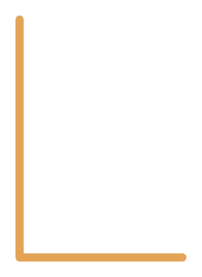

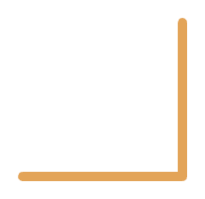



What a PCB is
LED
XTAL
LDO
The board
A flat fiberglass sheet that holds everything in place.
USB
MCU
C1
The traces
C2
Thin copper paths that act as wires between parts.
The parts
Chips, capacitors, connectors and more, soldered on top.
HDR
PCB placement with AlphaEvolve · 2
Notes:
A PCB is the green board inside every electronic device. The copper lines are the wires. This diagram is the 8-part toy board used in the rest of the deck.

Slide 3
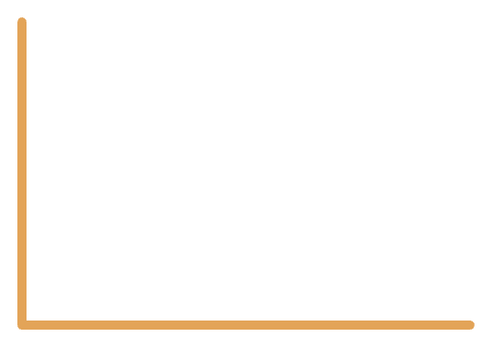
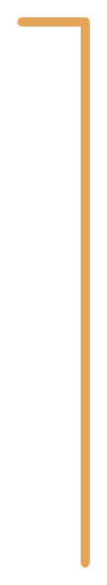
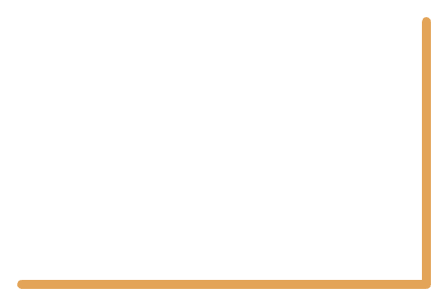



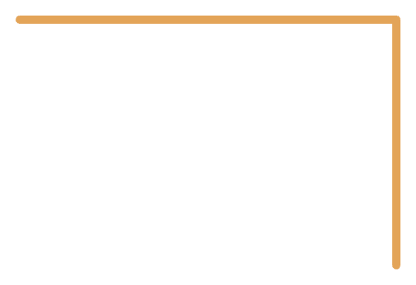
Why placement matters
Scattered placement
Tidy placement
C1
C2
XTAL
MCU
MCU
C1
LDO
C2
LDO
XTAL
Long wires: noisy clock, weak power filtering
Short wires: clean clock, strong power filtering
PCB placement with AlphaEvolve · 3
Notes:
Same five parts, same connections. Only the positions differ. Good placement is what makes the board cheaper, quieter and more reliable.

Slide 4
Find the best part placement automatically
THE END GOAL
Short wires, clean signals, no overlaps, everything inside the board.
Notes:
The aim is not to hand-tune one layout. It is to let a search process discover good placement methods on its own.

Slide 5
The toy board
Part | Role | Size (mm)
MCU | Microcontroller chip | 7 × 7
XTAL | Crystal (clock) | 3 × 2.5
C1, C2 | Decoupling capacitors | 1.6 × 0.8
LDO | Voltage regulator | 3 × 3
USB | Power connector | 8 × 6
HDR | Pin header | 10 × 3
LED | Indicator light | 1.6 × 0.8
THE BOARD
50 × 50 mm
THE WIRING: 8 CONNECTIONS
MCU to XTAL (clock)
MCU to C1 and C2 (power filtering)
USB to LDO, LDO to C1 and C2 (power)
MCU to HDR and LED (signals)
PCB placement with AlphaEvolve · 5
Notes:
This is the entire problem definition: board size, part sizes, and which parts must be wired together. Positions are deliberately left out, finding them is the job.

Slide 6
Rules and goals
Goal | Weight | Why it matters
Short total wire length | ×1 | Less noise, lower cost
Crystal near the MCU | ×3 | Clean clock signal
Capacitors near the MCU | ×3 | Stable power
Regulator far from crystal | ×0.5 | Heat and noise kept apart
HARD RULES
Break one and the layout is invalid
Every part stays inside the board
No two parts overlap (0.3 mm gap)
PCB placement with AlphaEvolve · 6
Notes:
Hard rules are pass/fail. Goals are scored. The weights say how much each goal matters; the regulator bonus is capped at 20 mm so it cannot dominate.

Slide 7


The AlphaEvolve loop
1
2
3
4
Program
LLM edits
Evaluator
Keep the best
Code that decides where each part goes.
A language model proposes changes to the code.
Runs the code and scores the layout it produces.
Top programs become parents of the next round.
Repeat hundreds of times. Better programs breed better programs.
PCB placement with AlphaEvolve · 7
Notes:
AlphaEvolve is an evolutionary coding agent. You provide a starting program and an evaluator. The model mutates the program, the evaluator scores each version, and the best ones seed the next round.

Slide 8
Code, not coordinates
A NORMAL OPTIMIZER
ALPHAEVOLVE
Tweaks the numbers
Rewrites the recipe
16 values: the x and y position of each of the 8 parts.
The program that picks positions: center the MCU, cluster neighbors, anneal, fix overlaps.
Result: one layout for one board.
Result: a method that works on new boards too.
PCB placement with AlphaEvolve · 8
Notes:
This is the key idea. The thing being evolved is the placement algorithm, not a fixed list of coordinates, so the result generalizes.

Slide 9
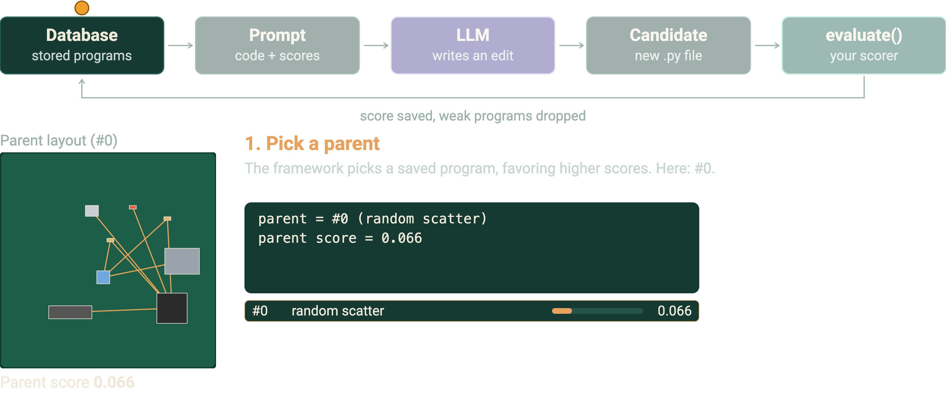
One round, animated
Three rounds with the real programs and scores from this project. The LLM edits are described, not generated live.
Notes:
Each round: pick a parent, build a prompt, the LLM proposes an edit, the edit is saved as a candidate file, evaluate() scores it, and the result is kept or dropped. Round 1 fails the overlap rule and is dropped. Rounds 2 and 3 improve the score from 0.066 to 0.243 to 0.281. The loop repeats by itself; viewers cannot click inside the embed.

Slide 10

What the LLM receives
One message per candidate. The model keeps no memory, so all it knows is in here.
1 THE TASK (from your config)
Place 8 parts on a 50×50 mm board. Rules: inside the board, no overlaps. Goals: short wires, crystal and caps by the MCU.
WHAT COMES BACK
- pos = {"MCU": (25.0, 25.0)}
- for n in [...]:
- ...grid search...
+ pos = greedy()
+ cur = cost(pos)
+ for step in range(6000):
+ t = 6.0 * 0.01 ** (step / 6000)
+ pos[n] = nudge(old, n, rng)
+ ...
2 THE PARENT PROGRAM
def place(seed=0):
pos = {"MCU": (25.0, 25.0)}
...grid search for each part...
3 THE PARENT'S SCORES (from evaluate)
combined_score 0.243 · wirelength 50.0
xtal_dist 6.0 · decap_dist 5.0 · ldo_to_xtal 10.0
4 OTHER GOOD PROGRAMS
The framework applies the edit, saves a new file, and calls evaluate() on it. The model itself never changes.
A few top-scoring programs, with their scores.
5 THE REQUEST
Improve the score. Edit only the EVOLVE-BLOCK region.
PCB placement with AlphaEvolve · 10
Notes:
The prompt is rebuilt every round from the database: the task text, a parent chosen by score, that parent's metrics, and a few other strong programs. Learning lives in what gets put into the prompt, not in the model weights. Numbers shown are the real evaluator output for the stage 2 program.

Slide 11
The evaluator
1 Run
2 Check rules
3 Measure
4 Combine
Call place() to get the positions.
Inside the board? Any overlaps? If broken, score 0.
Wire length and the key distances.
One number from 0 to 1. Higher is better.
THE SCORE
cost = wire + 3*crystal + 3*caps - 0.5*min(regulator, 20)
score = 1 / (1 + cost / 25)
Invalid layouts score exactly 0 and every valid layout scores above 0, so a broken layout never wins.
PCB placement with AlphaEvolve · 11
Notes:
The score is bounded between 0 and 1, so scoring an invalid layout as 0 is safe: it can never beat a valid layout. The evaluator is the most important part: it must be fast, deterministic and hard to cheat.

Slide 12
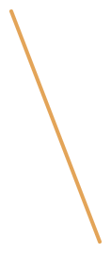
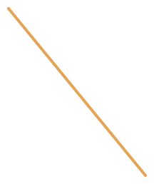
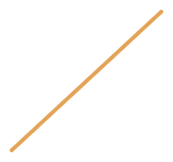











What evaluate() does
score = 1 / (1 + cost / 25), cost = wire + 3·crystal + 3·caps − 0.5·min(LDO to crystal, 20)
Crammed together
Random scatter
Refined (final)
Inside the board: pass
Inside the board: pass
Inside the board: pass
No overlaps: FAIL, MCU and XTAL
No overlaps: pass
No overlaps: pass
Stop. Nothing else is measured.
Wire 210.5 · crystal 29.2 · caps 21.0
Wire 39.8 · crystal 5.4 · caps 4.9
Score 0
Cost 353.4
Cost 64.0
Score 0.066
Score 0.281
PCB placement with AlphaEvolve · 12
Notes:
Real layouts scored by evaluator.py in the code zip: the crammed layout is example_overlap.py, the others are initial_program.py and stage3_anneal.py. Rules are pass or fail and checked first; goals are measured only for legal layouts.

Slide 13
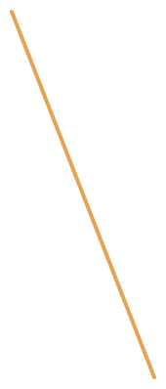
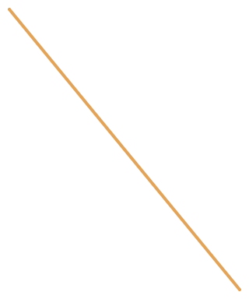






Start: random scatter
The seed program. It picks random spots and ignores both the rules and the wiring.
initial_program.py · place()
MCU
def place(seed=0):
rng = random.Random(seed)
pos = {}
for name, (w, h) in COMPONENTS.items():
pos[name] = (rng.uniform(w / 2, BOARD[0] - w / 2),
rng.uniform(h / 2, BOARD[1] - h / 2))
return pos
XTAL
C1, C2
LDO
USB
HDR
LED
What it does
Picks a random spot for every part
Never checks for overlaps (about 4 in 10 random seeds are legal; this one is)
Never looks at which parts connect
Score 0.066
Wire 210.5 mm · crystal 29.2 mm
Caps 21.0 mm · LDO to crystal 15.6 mm
PCB placement with AlphaEvolve · 13 · The seed program, scored by the real evaluator
Notes:
This is initial_program.py from the code zip. The score of 0.066 is real evaluator output. Random placement ignores both the rules and the wiring; in a quick check of 300 seeds, 125 gave legal layouts and the rest overlapped, which scores 0.

Slide 14
Middle: cluster around the MCU
MCU in the middle, then each part takes the free spot nearest the parts it connects to.
stage2_cluster.py · place() · amber = the new idea
MCU
def place(seed=0):
pos = {"MCU": (25.0, 25.0)}
for n in ["XTAL", "C1", "C2", "LDO", "USB", "HDR", "LED"]:
w, h = COMPONENTS[n]
best = None
for x in range(int(w / 2) + 1, int(BOARD[0] - w / 2)):
for y in range(int(h / 2) + 1, int(BOARD[1] - h / 2)):
if clash(n, x, y, pos):
continue
c = pull(n, x, y, pos)
if best is None or c < best[0]:
best = (c, x, y)
pos[n] = (best[1], best[2])
return pos
XTAL
C1, C2
LDO
USB
HDR
LED
Score 0.243
Wire 50.0 mm · crystal 6.0 mm
Caps 5.0 mm · LDO to crystal 10.0 mm
Up from 0.066 at the previous stage
PCB placement with AlphaEvolve · 14 · Hand-written stand-in for evolved code, scored by the real evaluator
Notes:
This is stage2_cluster.py from the code zip: a hand-written stand-in for the kind of program evolution might find. Its score of 0.243 is real evaluator output. The helpers clash() and pull() sit above the EVOLVE-BLOCK, so only place() is shown. A real evolved program will look different.

Slide 15


Final: refine with small moves
Start from the stage 2 layout, try 6,000 small moves, sometimes keep a worse one.
stage3_anneal.py · place() · amber = the new idea
MCU
def place(seed=0):
rng = random.Random(seed)
pos = greedy()
cur = cost(pos)
best, best_c = dict(pos), cur
for step in range(6000):
t = 6.0 * 0.01 ** (step / 6000)
n = rng.choice(NAMES)
old = pos[n]
pos[n] = nudge(old, n, rng)
new = cost(pos)
if new <= cur or rng.random() < math.exp((cur - new) / t):
cur = new
if cur < best_c and overlaps(pos) == 0:
best, best_c = dict(pos), cur
else:
pos[n] = old
return best
XTAL
C1, C2
LDO
USB
HDR
LED
Score 0.281
Wire 39.8 mm · crystal 5.4 mm
Caps 4.9 mm · LDO to crystal 13.3 mm
Up from 0.243 at the previous stage
PCB placement with AlphaEvolve · 15 · Hand-written stand-in for evolved code, scored by the real evaluator
Notes:
This is stage3_anneal.py from the code zip: a hand-written stand-in for a later, better program. Its score of 0.281 is real evaluator output. The helpers greedy(), cost() and nudge() sit above the EVOLVE-BLOCK, so only place() is shown. A real run will find different code and may do better or worse.

Slide 16
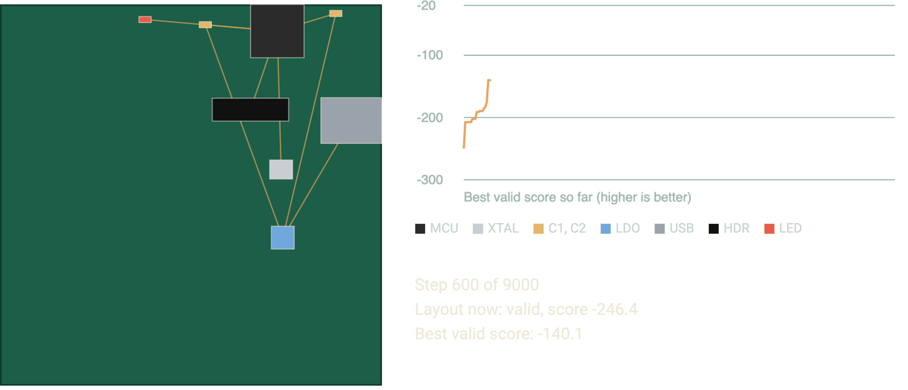
Simulation 1: one layout improving
Stand-in for an evolved placer: simulated annealing on the 8-part toy board. Red outline = overlap. Scores shown are the raw formula (closer to 0 is better); the code rescales them to 0 to 1.
Notes:
Starts from a random scatter (usually overlapping and invalid), then repeatedly nudges parts, accepting most improvements and a few setbacks early on. It restarts with a new random layout after each run. The same scoring formula as the evaluator is used.

Slide 17
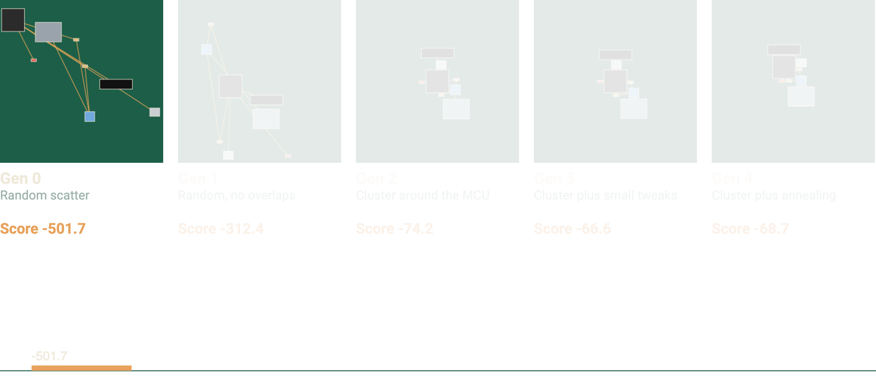
Simulation 2: five generations of placer code
Each generation is a different placement program, scored by the same evaluator. Red outline = overlap. Scores are the raw formula (closer to 0 is better).
Notes:
This is a stand-in for what evolution might discover over time: start with random scatter, remove overlaps, cluster around the MCU, then refine with small tweaks or annealing. Each board is produced by real code run live in this slide, and scored with the same formula.

Slide 18
Pitfalls to design around
Reward hacking
One number hides trade-offs
Evolution exploits any loophole. Keep rules as hard checks and cap bonus terms.
Track metrics separately, try several weightings, or keep a Pareto front.
Slow evaluators
Overfitting to one board
The scorer runs thousands of times. Use cheap proxies inside the loop.
Score on several board variants so the evolved method generalizes.
PCB placement with AlphaEvolve · 18
Notes:
Most of the effort in an AlphaEvolve project goes into the evaluator. Anything it forgets to check, evolution will find and exploit.

Slide 19
From toy to real board
1
2
3
4
5
Toy placement
Real geometry
Routing
Rule checks
Physics
8 parts, simple distances. The example in this deck.
Apply placements to a real board with KiCad's pcbnew API.
Run an autorouter. Count unrouted nets, vias and trace length.
Run the real design rule check. Require zero violations.
Add impedance, thermal and EMI estimates, costly ones on top candidates only.
Upgrade the evaluator, not the framework.
PCB placement with AlphaEvolve · 19
Notes:
Once the toy works end to end and beats a hand-written baseline, swap in richer evaluators one at a time, checking each for loopholes before adding the next.

